Slide 1
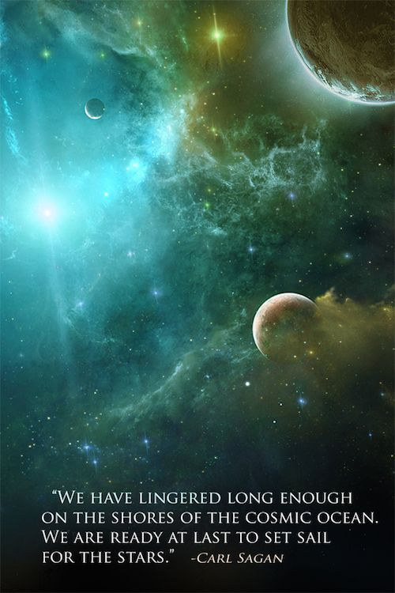
SPCE 5065 VACUUM ENVIRONMENT
Part 2: Contamination

Slide 2
CONTAMINATION

Slide 3
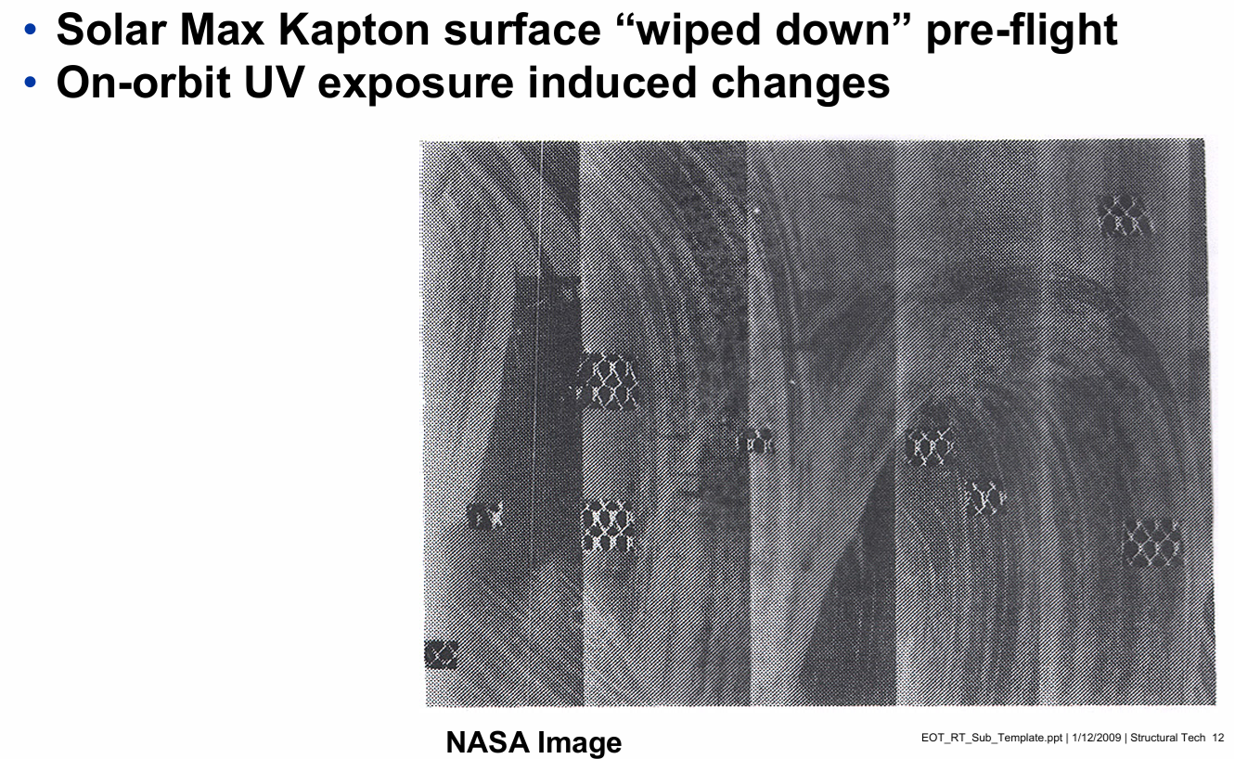
CONTAMINATION EXAMPLE

Slide 4
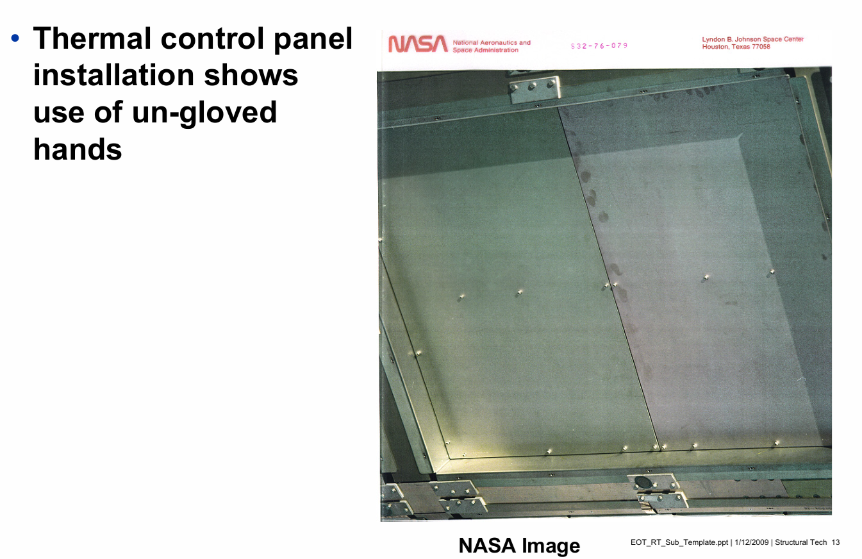
CONTAMINATION EXAMPLE

Slide 5
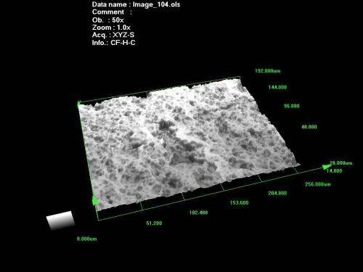
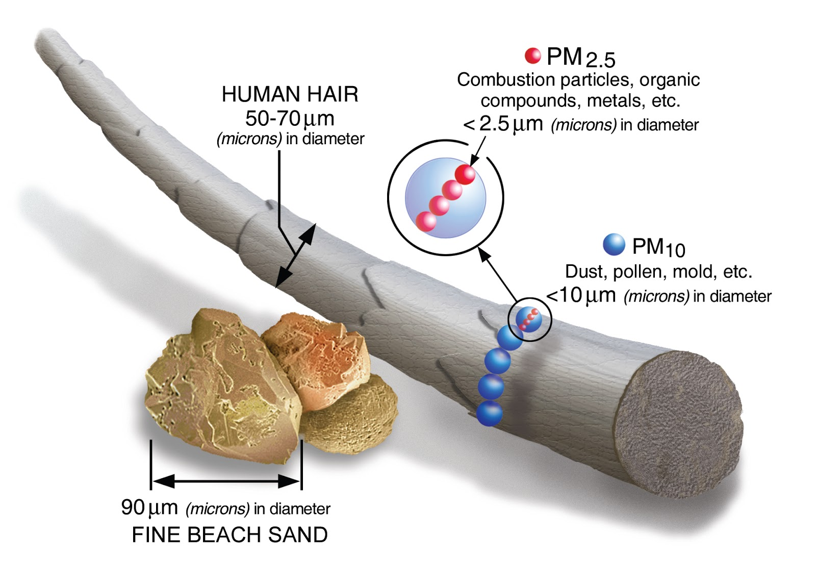
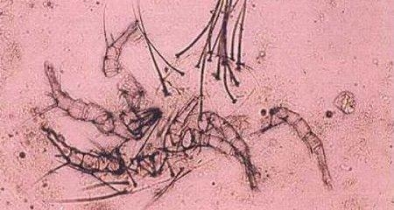
TYPES OF CONTAMINATION
Molecular
Particulate
Biological

Slide 6
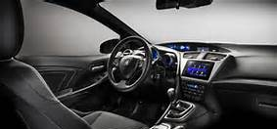
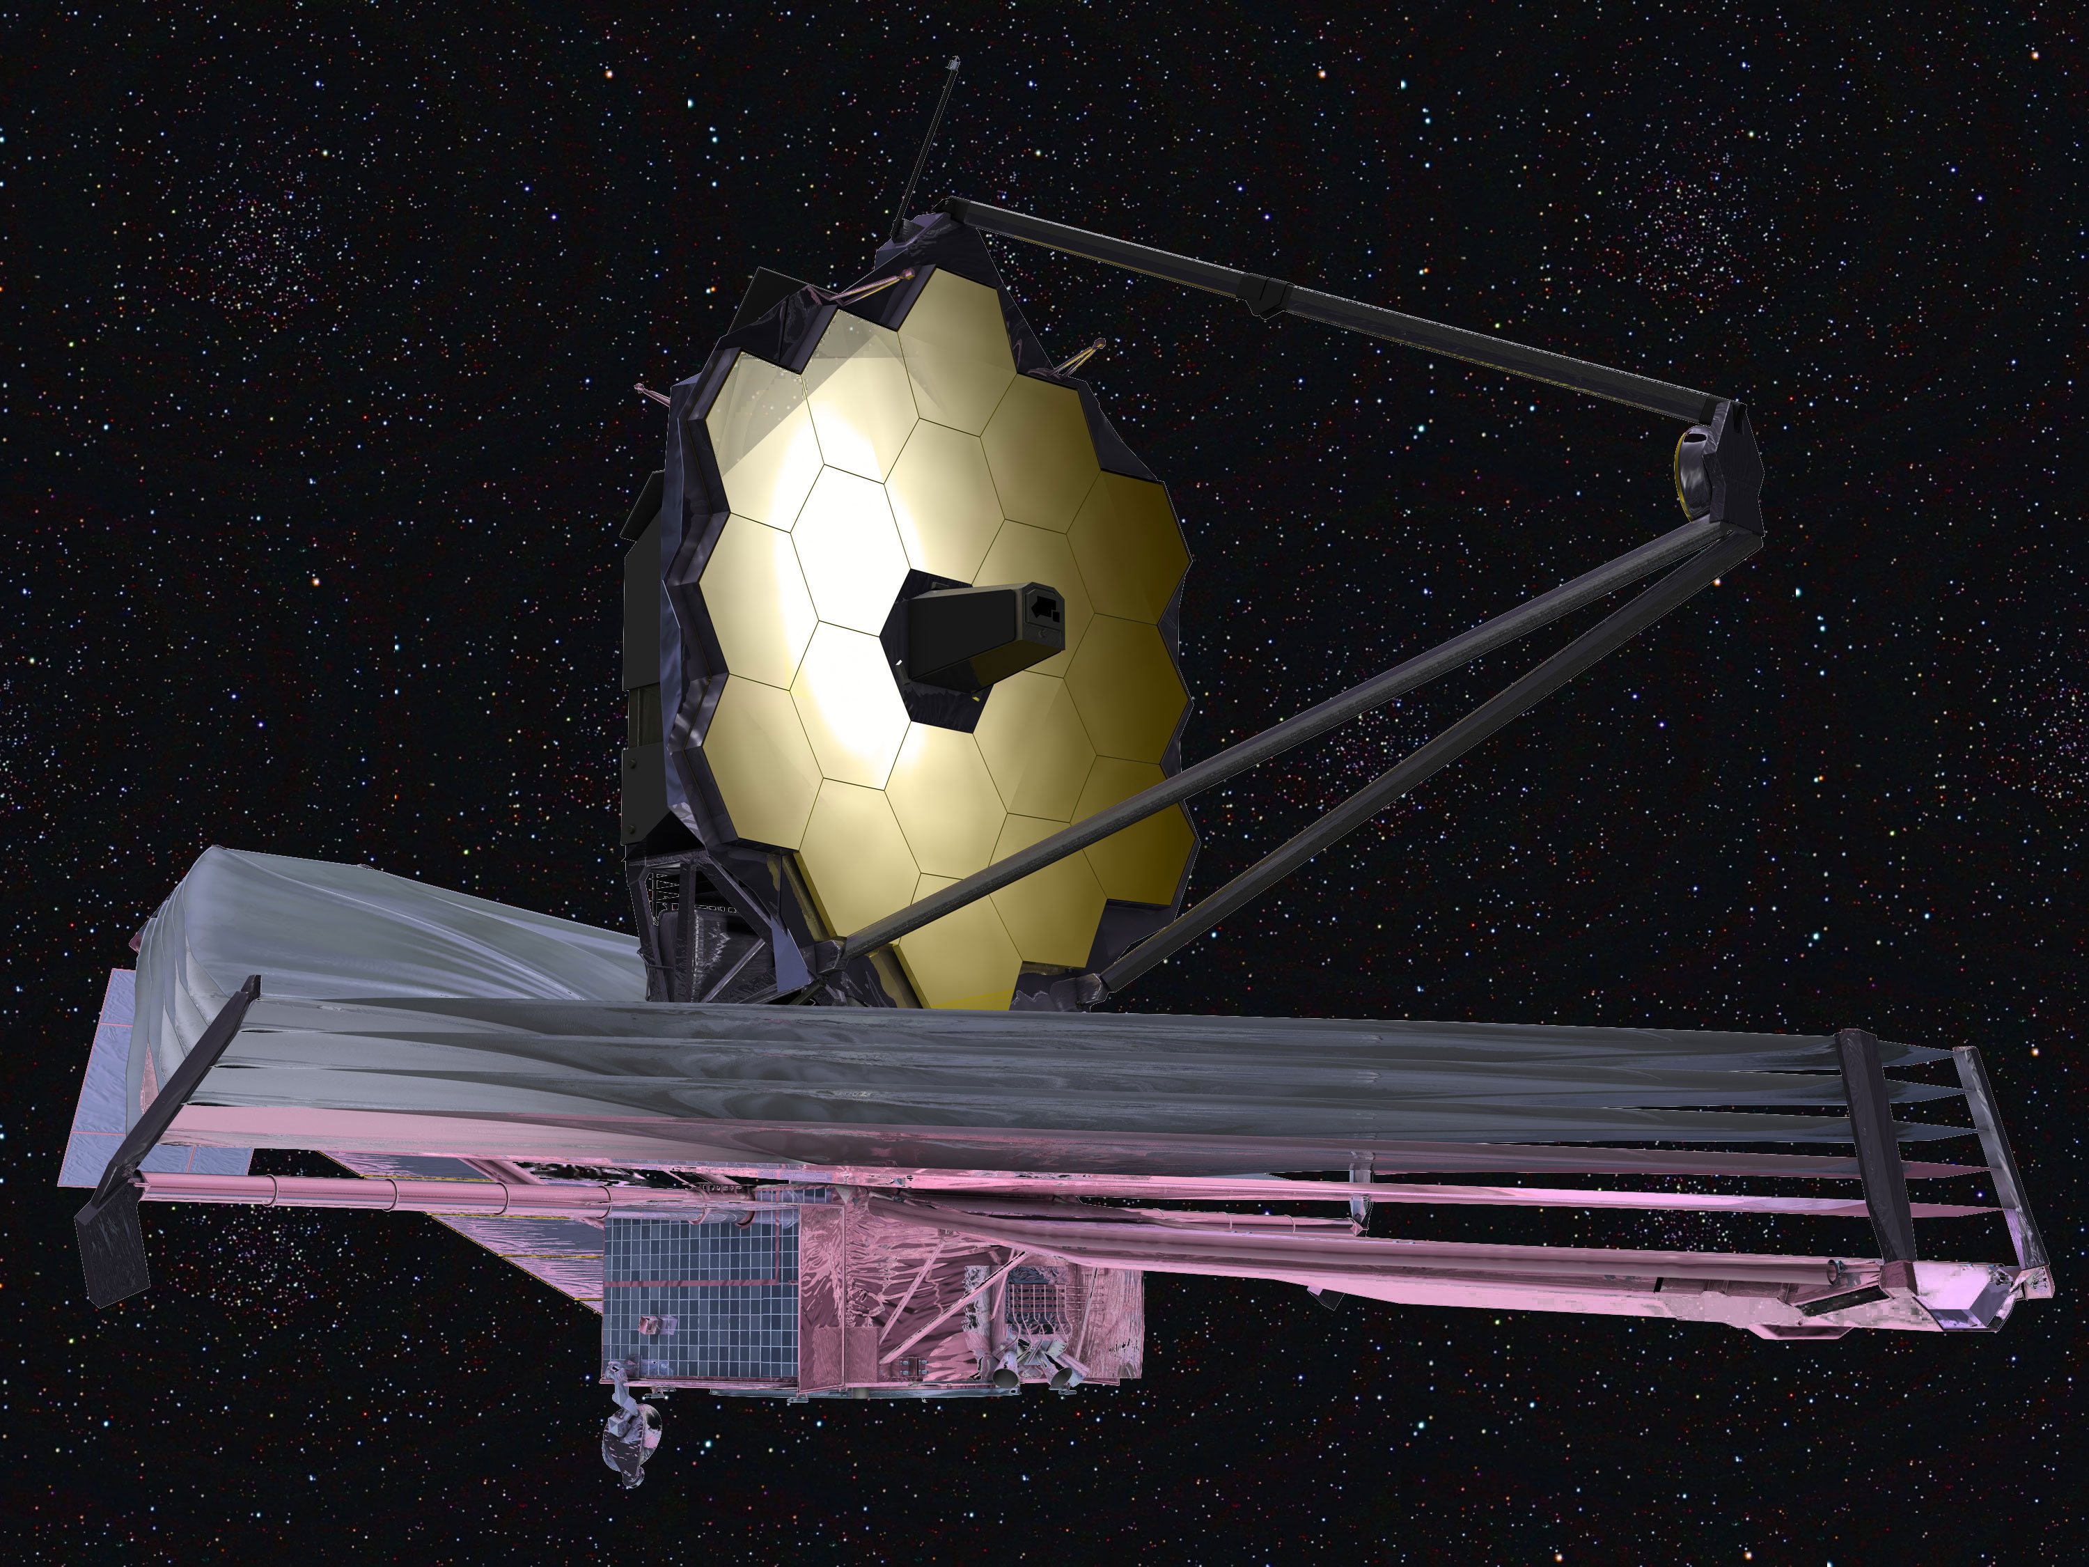
Vacuum Environment: MOLECULAR CONTAMINATION
Outgassing – the generation of spurious molecules which may act as contaminants to other surfaces
Surfaces sensitive to contamination include:
Thermal control surfaces
Solar arrays
Optical devices (sun and star sensors, telescopes, camera lenses)
Notes:
Accounts for much of the solar absorptance degradation during the mission
Mass loss due to exposure to very low pressures
Lubricants can be a big problem
And a thin contaminant film on the inside of your windshield
Tending to increase α and raise equilibrium temperature over time (historical values increased by a factor of 4 or 5 from beginning to end of life)
Once released, molecules follow ballistic trajectories and randomly impact other surfaces in line of sight
⇒ alter thermal and optical properties
Outgassing is important for a couple of reasons: the molecules can interfere with the instrument when high voltages are present, possibly damaging it; and they can absorb wavelengths of light, preventing the instrument from collecting all the information it could. To avoid these dangers, engineers waited until the outgassing was complete before bringing the instruments to full power

Slide 7
How does outgassing vary?
2) Inversely as a power of time
3) Independently of time
1) Exponentially as a function of time

Slide 8
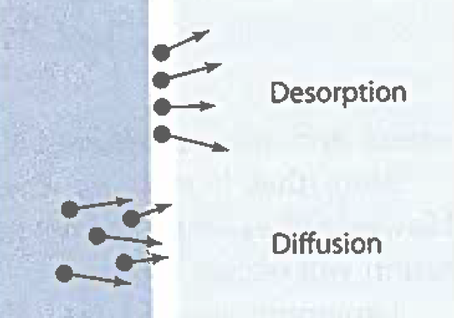
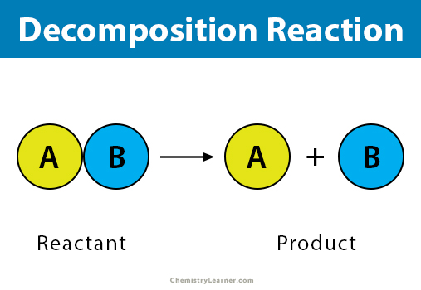
OUTGASSING
LARGELY VARIES WITH TIME
MECHANISMS
DESORPTION
DIFFUSION
DECOMPOSITION

Slide 9

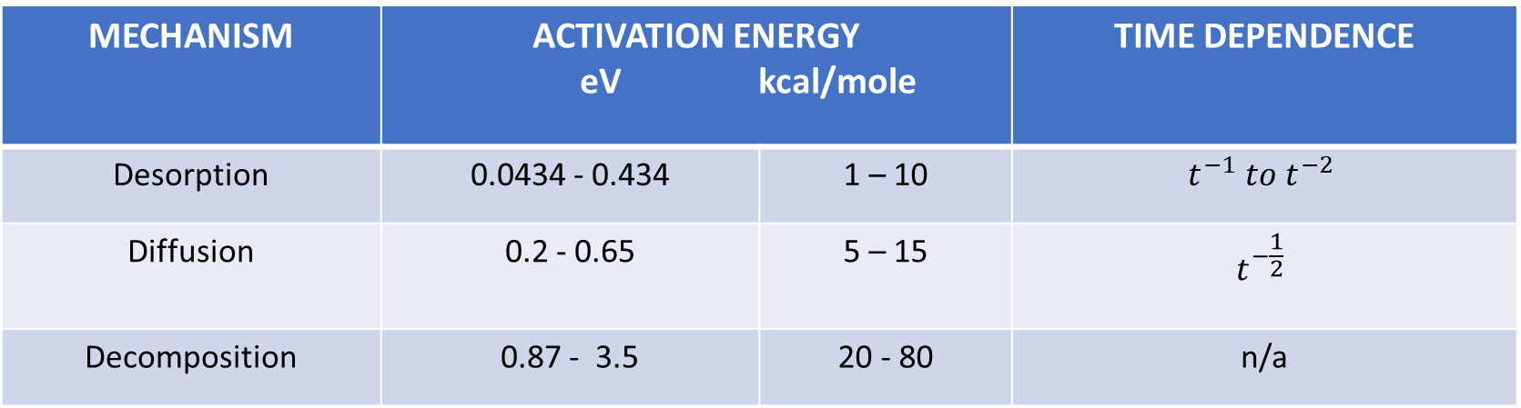
CHARACTISTICS OF OUTGASSING MECHANISMS
MECHANISM | ACTIVATION ENERGY eV kcal/mole |  | TIME DEPENDENCE
Desorption | 0.0434 - 0.434 | 1 – 10 | $$t^{−1} to t^{−2}$$
Diffusion | 0.2 - 0.65 | 5 – 15 | $$t^{−\frac{1}{2}}$$
Decomposition | 0.87 - 3.5 | 20 - 80 | n/a

Slide 10
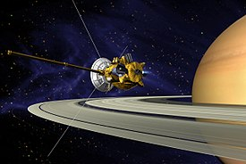
CASSINI NAC CONTAMINATION

Slide 11
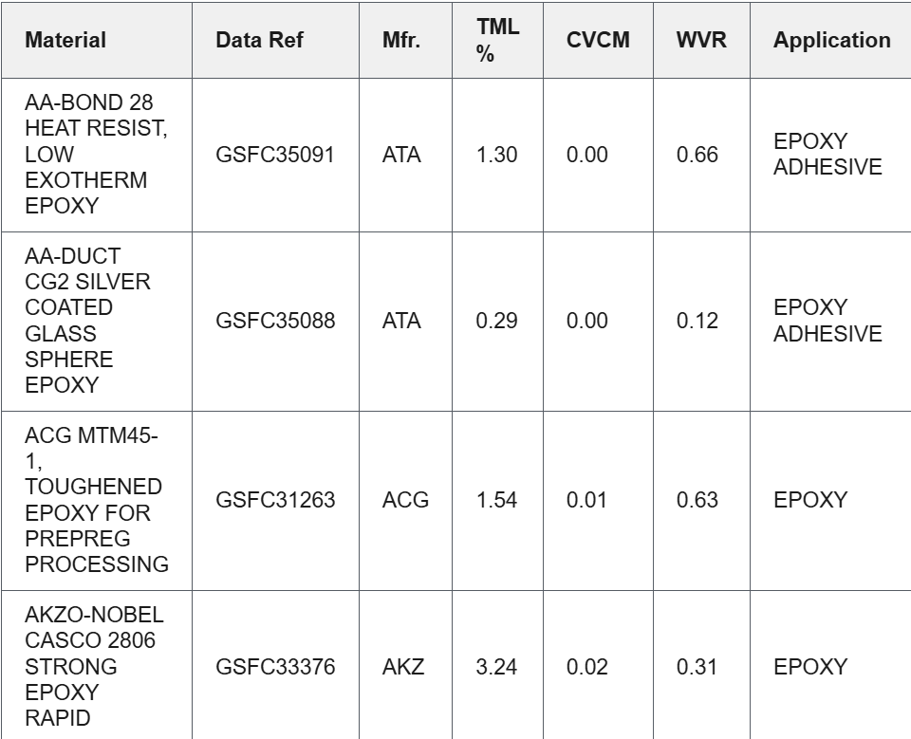
NASA OUTGASSING DATABASE

Slide 12
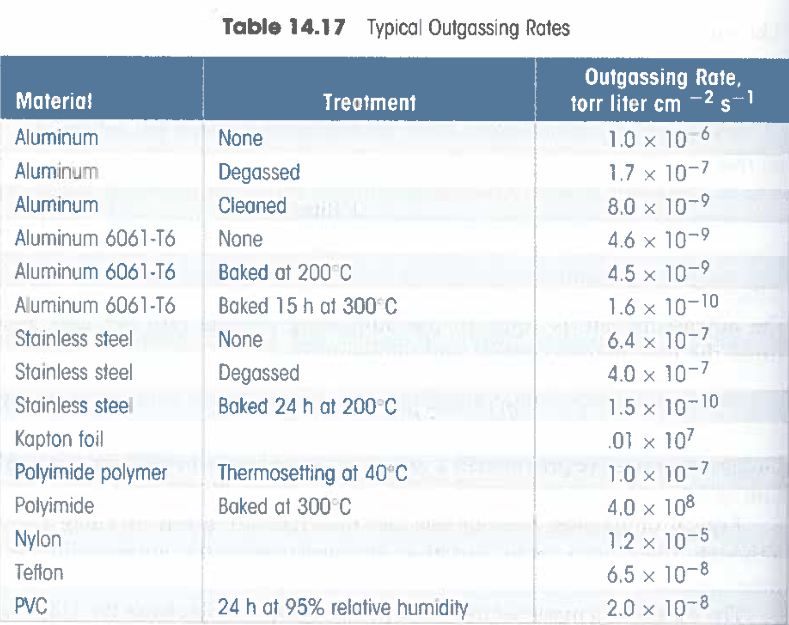
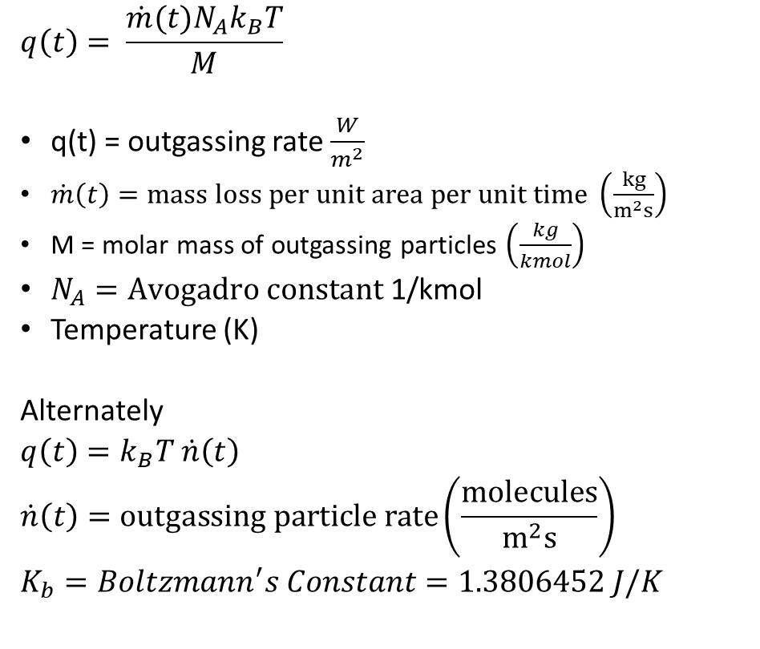
MEASURING OUTGASSING RATES
Outgassing Data for Selecting Spacecraft Materials Online | Outgassing (nasa.gov)
$$q\left(t\right)= \frac{\dot{m}(t)N_{A}k_{B}T}{M}$$
q(t) = outgassing rate $\frac{W}{m^{2}}$
$\dot{m}\left(t\right)=mass loss per unit area per unit time \left(\frac{kg}{m^{2}s}\right)$
M = molar mass of outgassing particles $\left(\frac{kg}{kmol}\right)$
$N_{A}=Avogadro constant$ 1/kmol
Temperature (K)
Alternately
$q\left(t\right)=k_{B}T$ $\dot{n}\left(t\right)$
$$\dot{n}\left(t\right)=outgassing particle rate\left(\frac{molecules}{m^{2}s}\right)$$
$$K_{b}=Boltzmann^{′}s Constant=1.3806452 J/K$$

Slide 13
NOTES ON MODELING

Slide 14
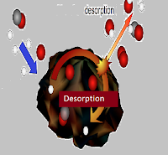
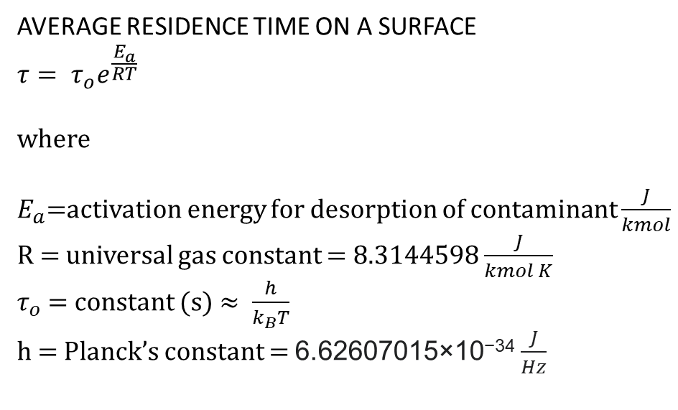
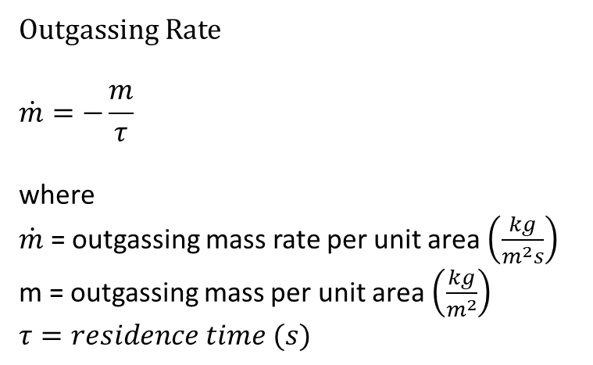
DESORPTION
Outgassing Rate
$$\dot{m}=−\frac{m}{τ}$$
where
$\dot{m}$ = outgassing mass rate per unit area $\left(\frac{kg}{m^{2}s}\right)$
m = outgassing mass per unit area $\left(\frac{kg}{m^{2}}\right)$
$$τ=residence time (s)$$
AVERAGE RESIDENCE TIME ON A SURFACE
$$τ= τ_{o}e^{\frac{E_{a}}{RT}}$$
where
$E_{a}$=activation energy for desorption of contaminant $\frac{J}{kmol}$
R = universal gas constant = 8.3144598 $\frac{J}{kmol K}$
$τ_{o}$ = constant (s) $≈ \frac{h}{k_{B}T}$
h = Planck’s constant = 6.62607015×10⁻³⁴ $\frac{J}{Hz}$

Slide 15
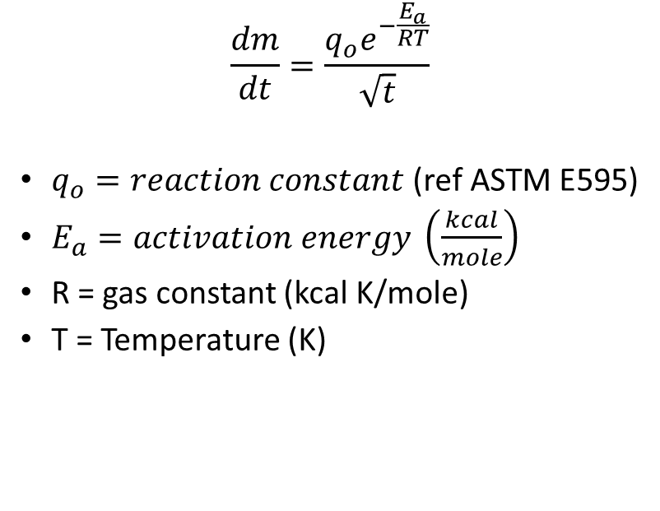
DIFFUSION
 | Limit
Total Mass Loss (TML, %) | 1.00 % max | 0.48
Collected Volatile Condensable Material (CVCM, %) | 0.10% max | <0.01
Water Vapor Regain (WVR, %) | Report | 0.39
$$\frac{dm}{dt}=\frac{q_{o}e^{−\frac{E_{a}}{RT}}}{\sqrt{t}}$$
$q_{o}=reaction constant$ (ref ASTM E595)
$E_{a}=activation energy \left(\frac{kcal}{mole}\right)$
R = gas constant (kcal K/mole)
T = Temperature (K)

Slide 16
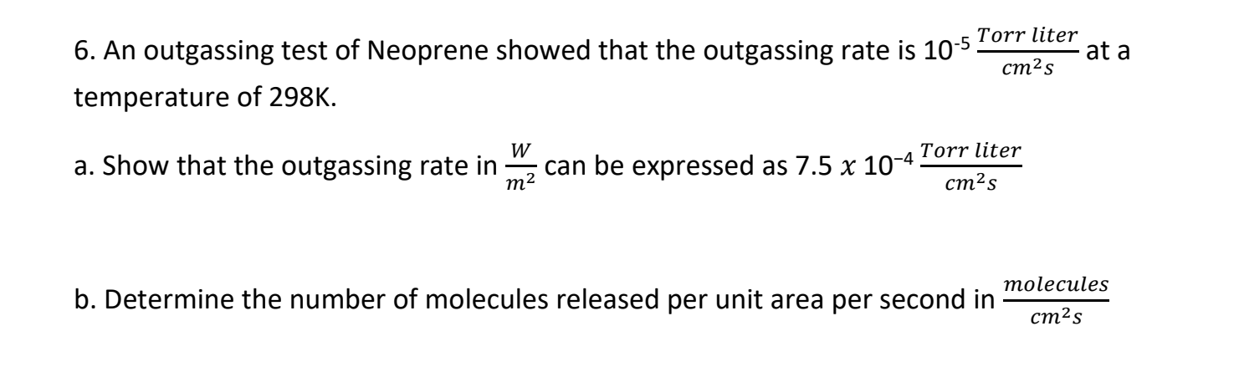

HOMEWORK PROBLEM 6

Slide 17
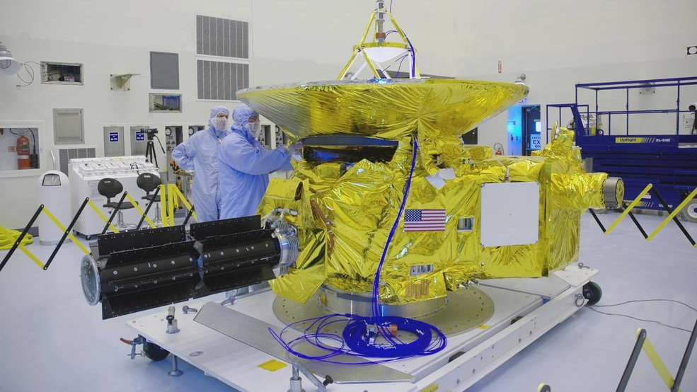
PARTICULATE CONTAMINATION

Slide 18
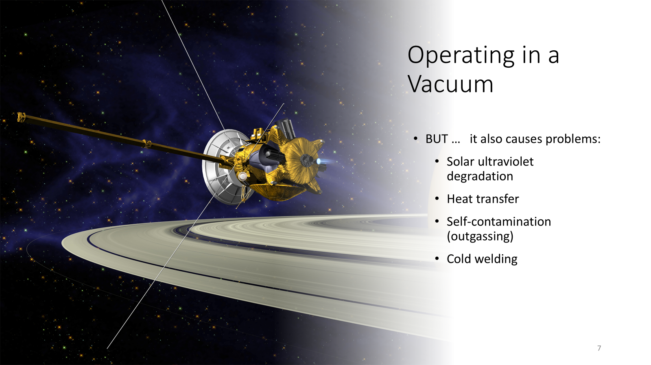

Slide 19
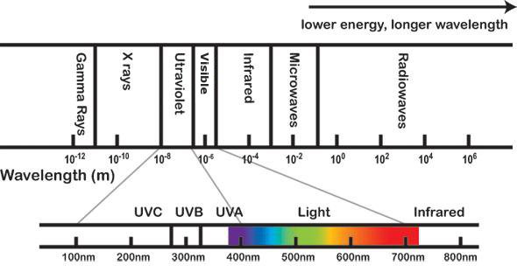
SOLAR UV DEGRADATION
Physics Classifications
Name Abbreviation Wavelength (nm) Energy (eV)
Near Near UV 300 - 400 4.13 – 3.10
Middle MUV 200 – 300 6.20 – 4.13 Far FUV, VUV 100 – 200 12.4 – 6.20 Extreme EUV, XUV 10 – 100 124 – 12.4
Biology Classifications
Name Abbreviation Wavelength (nm) Energy (eV)
Long-λ UVA 320 – 400 3.94 – 3.10 Medium-λ UVB 290 – 320 4.43 – 3.94
Short-λ UVC 100 – 290 12.4 – 4.43

Slide 20
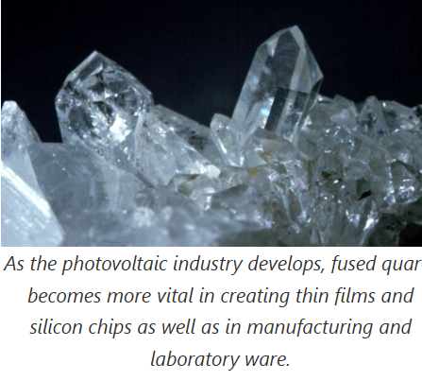

USEFUL USES
Fused quartz glass (fused silica)
- transparent and used to cover solar cells to maximize η

Slide 21
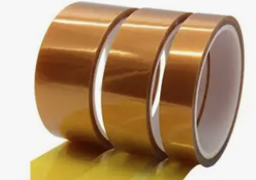
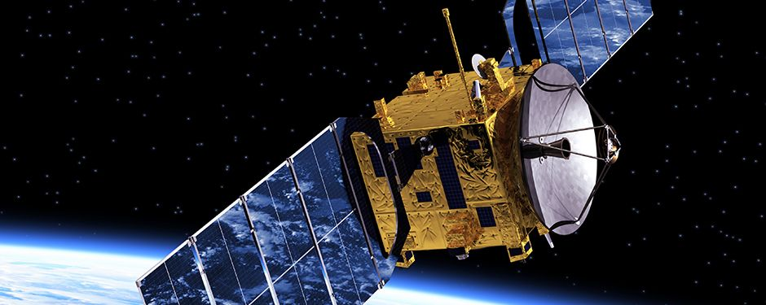
MITIGATING UV DEGRADATION KAPTON POLYIMIDE FILM AND TAPE
4 – 673 K (-269 – 400 °C)

Slide 22
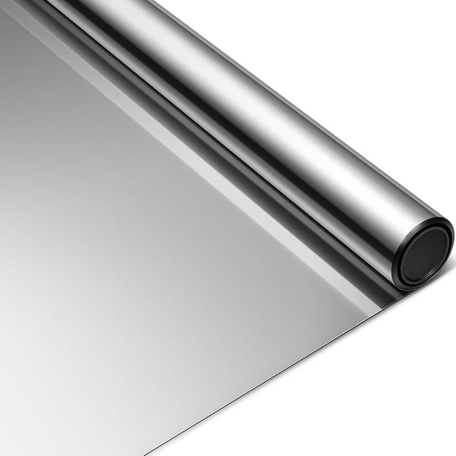
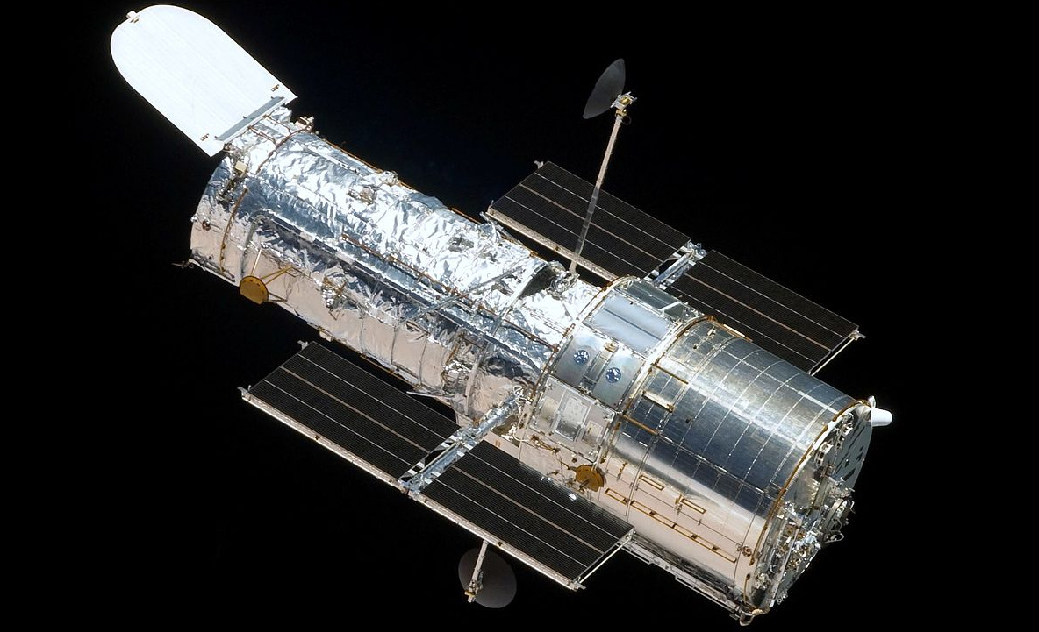
MITIGATING UV DEGRADATION MYLAR POLYESTER FILM
200 – 450 K (-73 – 177 °C)

Slide 23

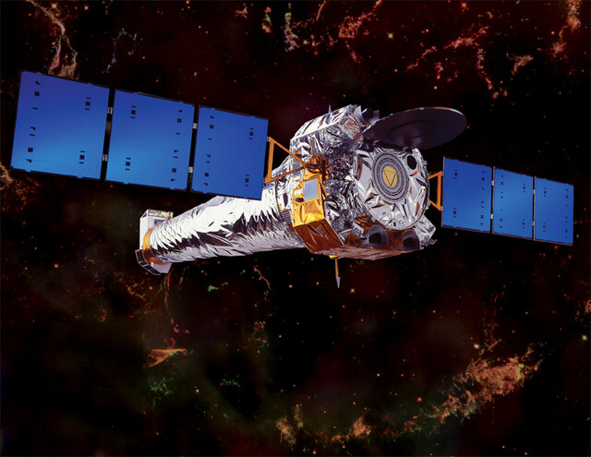
MITIGATING UV DEGRADATION TEFLON
123 – 533 K (-150 - 260°C)

Slide 24
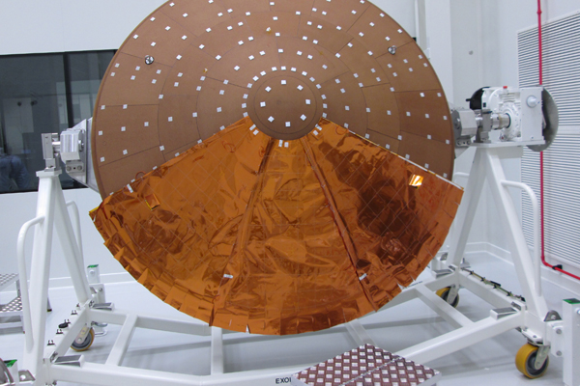
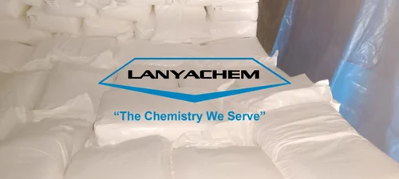
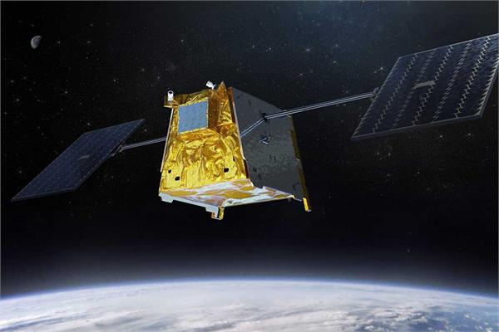
MITIGATING UV DEGRADATION UV BLOCKERS, ABSORBERS & STABILIZERS
Blockers
Stabilizers
Absorbers

Slide 25
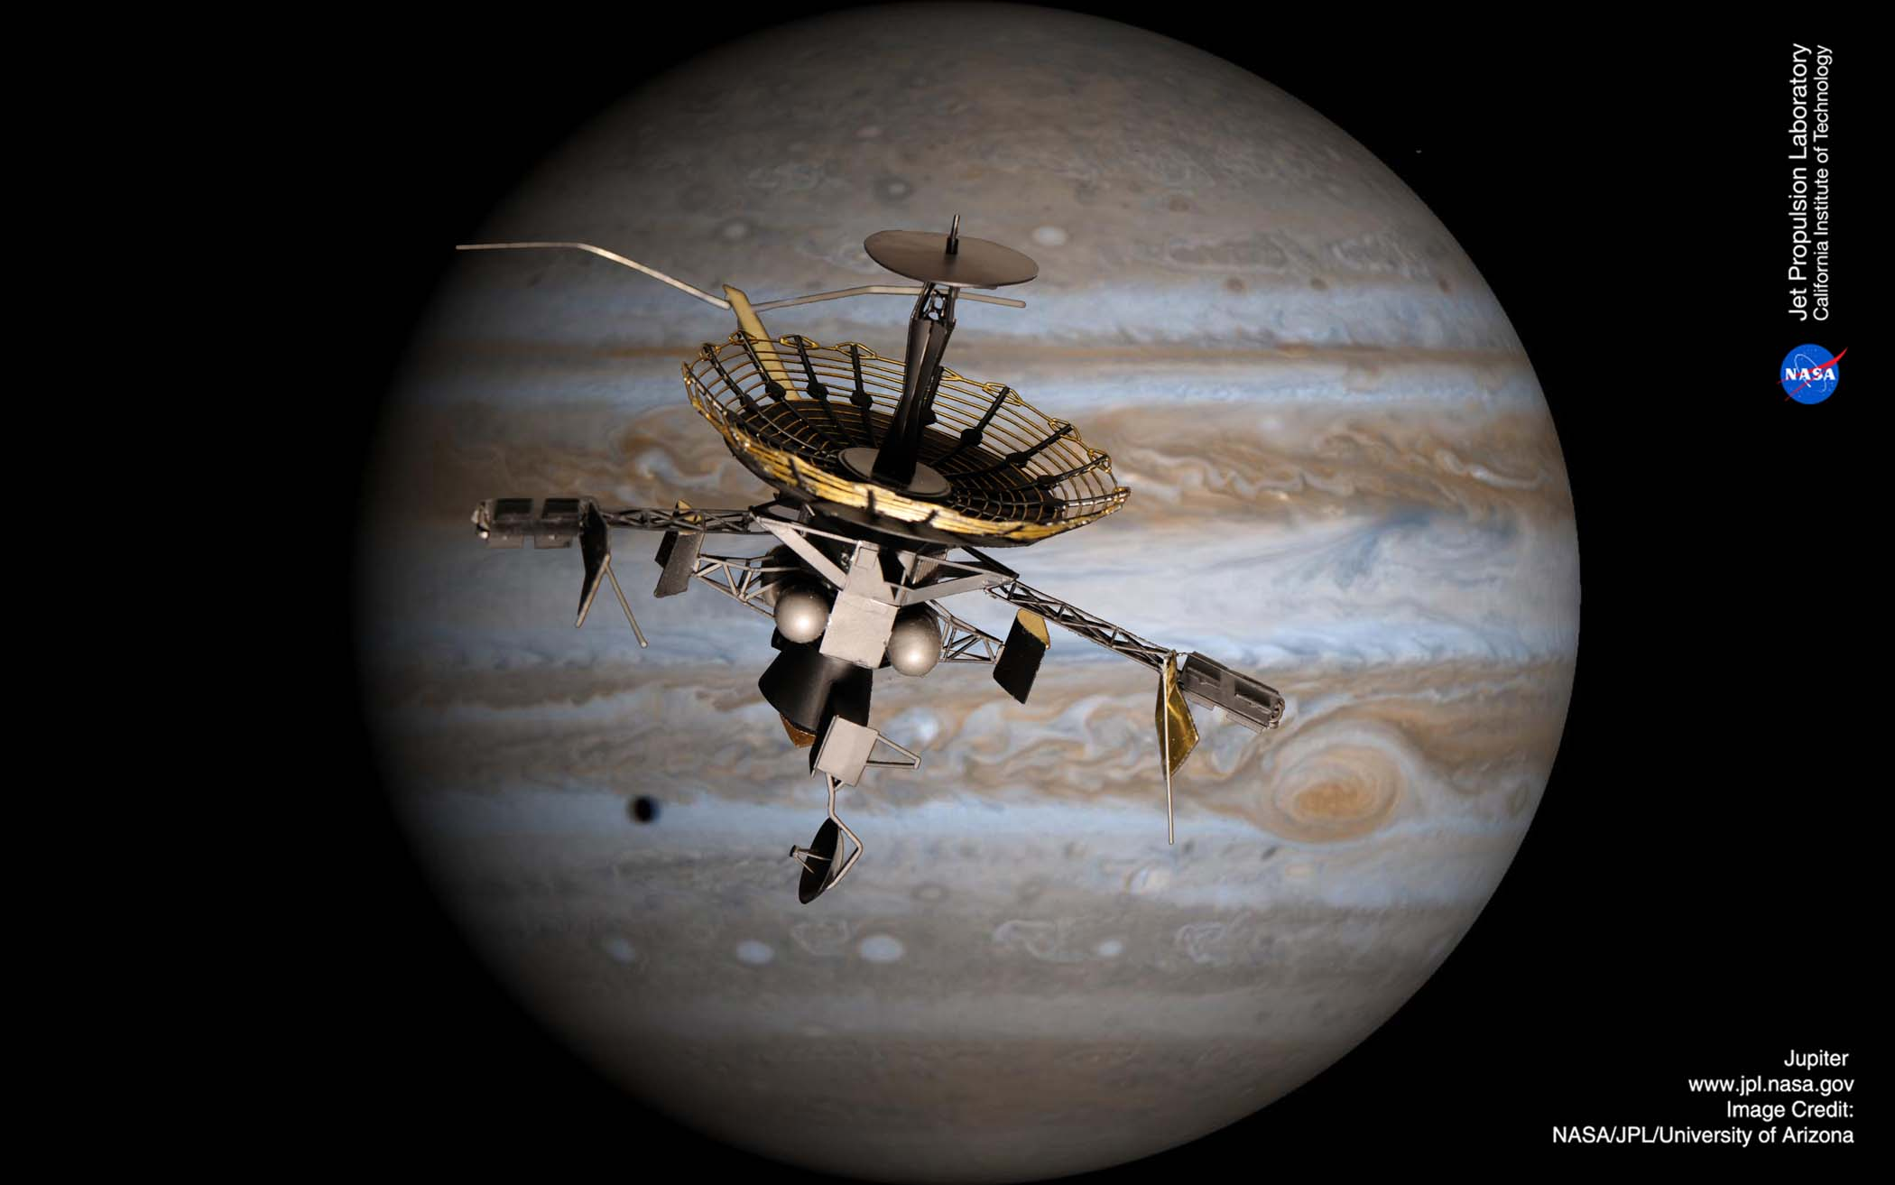
COLD WELDING
Cold welding – the unintended bonding of materials because of lack of atmosphere between surfaces
Notes:
Accounts for much of the solar absorptance degradation during the mission
Mass loss due to exposure to very low pressures
Lubricants can be a big problem
And a thin contaminant film on the inside of your windshield
Tending to increase α and raise equilibrium temperature over time (historical values increased by a factor of 4 or 5 from beginning to end of life)
Once released, molecules follow ballistic trajectories and randomly impact other surfaces in line of sight
⇒ alter thermal and optical properties
The reason for this unexpected behavior is that when the atoms in contact are all of the same kind, there is no way for the atoms to “know” that they are in different pieces of copper. When there are other atoms, in the oxides and greases and more complicated thin surface layers of contaminants in between, the atoms “know” when they are not on the same part.
— Richard Feynman, The Feynman Lectures, 12–2 Friction
Cold welding were later observed, for example in 1991 Galileo Spacecraft^{[1]}on its way to Jupiter. During the deployment sequence of the High Gain Antenna, the antenna, which opens like an umbrella, never reached the fully deployed position.

Slide 26

COLD WELDING

Slide 27
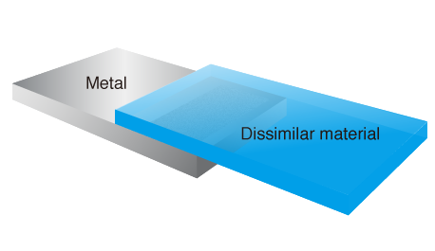
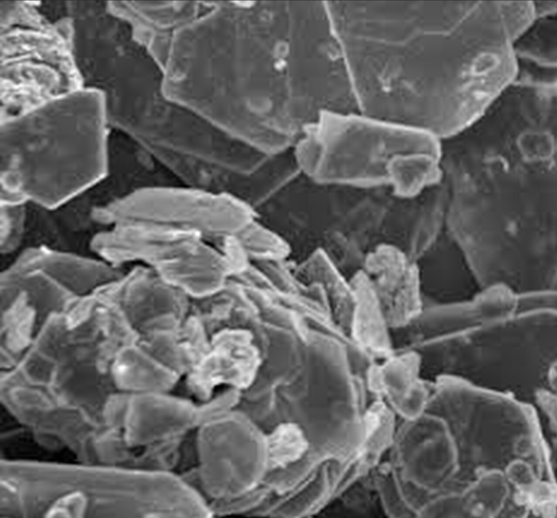
METHODS TO PREVENT COLD WELDING
Use of dissimilar materials
Surface coatings and platings
Lubrication
Design strategies
Cleaning and handling controls

Slide 28
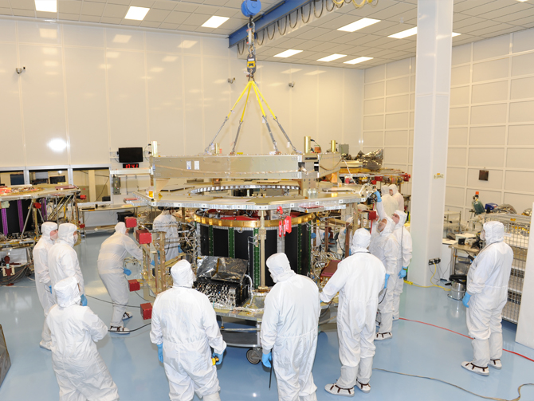
CONTAMINATION CONTROL

Slide 29
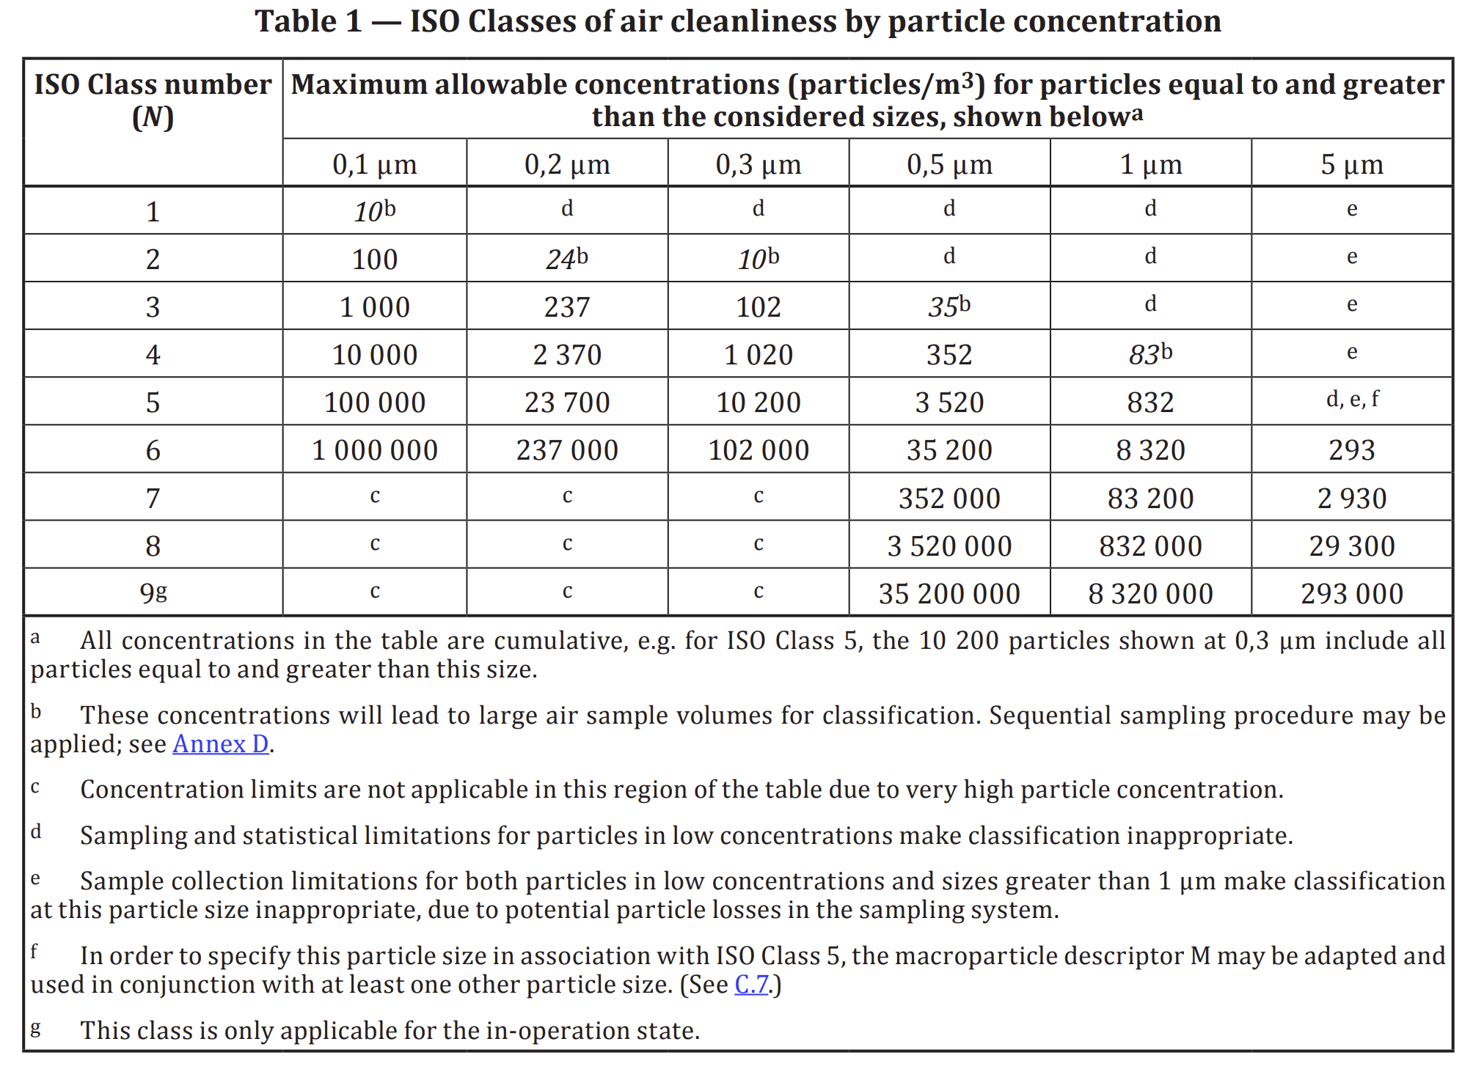
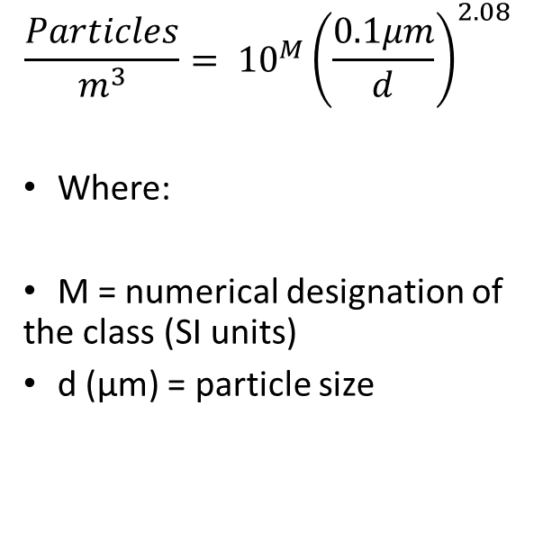

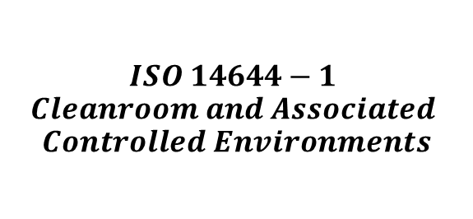
$$PARTICLE CONCENTRATION LIMITS$$
$$\frac{Particles}{m^{3}}= {10}^{M}{\left(\frac{0.1μm}{d}\right)}^{2.08}$$
Where:
M = numerical designation of the class (SI units)
d (μm) = particle size
$$ISO 14644−1$$
$$Cleanroom and Associated$$
$$Controlled Environments$$

Slide 30
EXAMPLE
For ISO Class 7 (Fed Std 209 class 10000), how many particles are allowable per cubic meter > 0.5 μm?
For ISO Class 3 (Fed Std 209 class 10), how many particles are allowable per cubic meter > 0.2 μm?

Slide 31
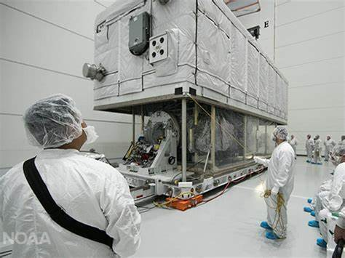

CONTAMINATION CONTROL PROGRAM
Establish Cleanliness specifications
Select and test materials carefully
- Thermal bakeout for $≥72$hours
Monitor
3. Establish and maintain clean surfaces – class 10000 (N7) or higher
Follow strict contamination control procedures
5. Contamination control during transport
6. Launch vehicle class 100 to 1000

Slide 32
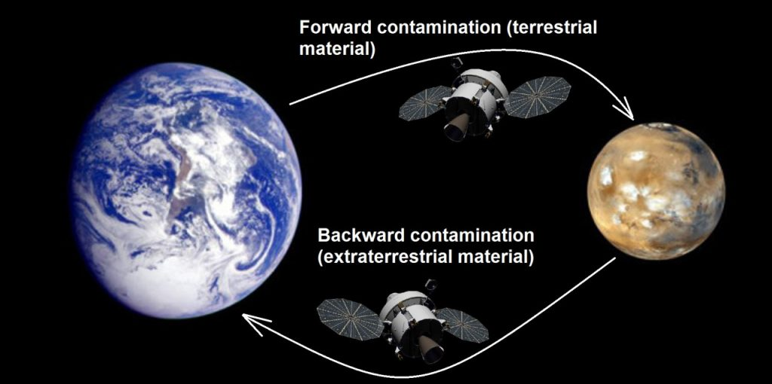
BIOLOGICAL CONTAMINATION

Slide 33
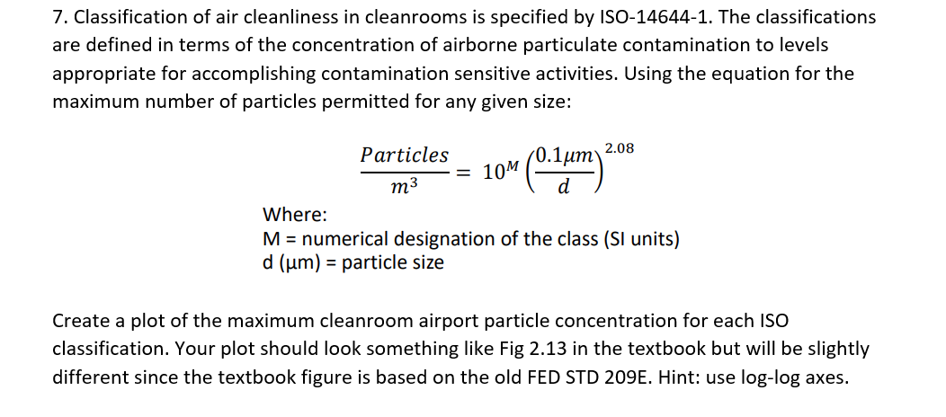
HOMEWORK PROBLEM 7

Slide 34
REFERENCES
Decomposition Reaction: Definition, Examples, & Applications. Chemistry Learner. (2021, June 7). https://www.chemistrylearner.com/chemical-reactions/decomposition-reaction
Hannifin, P. (n.d.). Why is Outgassing Critical in Optics and Electronics Applications? Motion & Control Technology Blogs. http://blog.parker.com/why-is-outgassing-critical-in-optics-and-electronics-applications#:~:text=Weight%20loss%20of%20compounds%20in%20a%20vacuum%20,Report%20%20%200.39%20%20%200.17%20.
𝑰𝑺𝑶 𝟏𝟒𝟔𝟒𝟒−𝟏 𝑪𝒍𝒆𝒂𝒏𝒓𝒐𝒐𝒎 𝒂𝒏𝒅 𝑨𝒔𝒔𝒐𝒄𝒊𝒂𝒕𝒆𝒅 𝑪𝒐𝒏𝒕𝒓𝒐𝒍𝒍𝒆𝒅 𝑬𝒏𝒗𝒊𝒓𝒐𝒏𝒎𝒆𝒏𝒕𝒔. (2015).
Loff, S. (2017, July 4). New Horizons Spacecraft in the Clean Room at NASA Kennedy. NASA. https://www.nasa.gov/image-feature/new-horizons-spacecraft-in-the-clean-room-at-nasas-kennedy-space-center.
NASA. (2025, May 28). Vacuum outgassing database. NASA. https://etd.gsfc.nasa.gov/capabilities/capabilities-listing/vacuum-outgassing-database
NASA. (2009, January 6). Contamination examples and lessons from low Earth orbit experiments and operational hardware - NASA technical reports server (NTRS). NASA. https://ntrs.nasa.gov/citations/20090028697
Pisacane, V. L. (2016). The space environment and its effects on space systems. American Institute of Aeronautics and Astronautics.
Rocheleau, J. (2014, June 20). What is Outgassing – Release of Gas from Trapped & Frozen Material. Planet Facts. https://planetfacts.org/outgassing/.
Solar Power Engineering (2011, June 7). How fused quartz improves solar panels. Solar Power World. https://www.solarpowerworldonline.com/2010/08/fused-quartz-a-critical-component-of-the-solar-power-industry/

